Slide 1
Cloud Presentation
Ryan Coon
CYB-525
Dr. Emmett Ward
January 1, 2025

Slide 2
Table of contents
Introduction
Virtualization platforms
Cloud Services
Cloud Models
Service-oriented Architecture
Deployment Models
Security, Storage, Legal and Privacy Issues

Slide 3
Introduction
Cloud computing is a methodology by which customers have on-demand access to information technology resources such as storage, networks, and servers via a network connected to the Internet. Clouds are centralized repositories of virtual resources that are managed and automated by software. These resources are accessible on-demand through self-service portals and are scaled automatically and distributed dynamically. This presentation will cover topics including virtualization platforms, cloud services, deployment strategies, security, storage, and legal and privacy concerns.

Slide 4
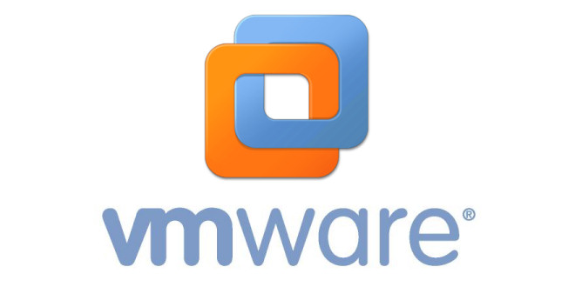
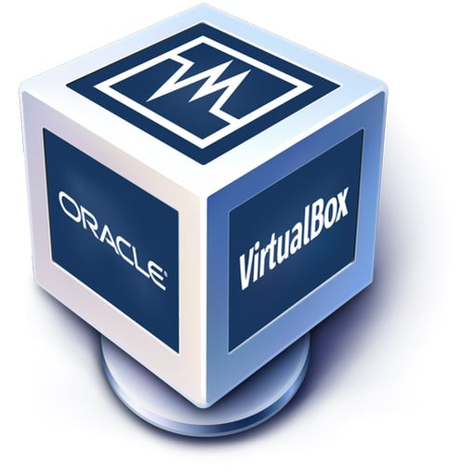
Virtualization Platforms
Virtualization is the enabling technology that allows for the implementation of cloud computing. Cloud computing is a service that is derived from the way virtualization software alters the physical hardware below. Virtualization is a prerequisite for utilizing cloud computing. A cloud platform is formed when all the hardware and computers in a data center are interconnected and functioning collectively.
The primary virtualization platforms include:
Microsoft
VMWare
Oracle VirtualBox
Citrix Hypervisor

Slide 5
Cloud services
PAAS
SAAS
Platform-as-a-Service (PaaS) is a form of cloud computing that provides users with comprehensive access to essential resources, including hardware, software, and infrastructure, enabling them to develop, execute, and oversee applications in the cloud. This eliminates the burdensome tasks, costs, and limited scalability associated with establishing and sustaining such a system independently. All the necessary components to operate the application, including servers, networks, storage, operating system software, databases, and development tools, are located within the data center of the Platform as a Service (PaaS) provider. By utilizing either model, customers of Platform as a Service (PaaS) can expedite and reduce costs associated with creating, testing, deploying, running, updating, and scaling applications compared to the alternative of constructing and overseeing their own on-premises platform. One instance is my data center where ServiceNow and SharePoint are hosted.
Software as a service (SaaS) is a software delivery model that replaces the requirement for installing and maintaining software on local servers by hosting applications in a cloud-based environment. The SaaS provider ensures the security, availability, and performance of the application. Netflix exemplifies a software as a-service company that provides on-demand streaming video.

Slide 6
Cloud models
DAAS
IAAS
DaaS, short for "Desktop as a Service" Desktop as a service (DaaS) is a form of cloud computing in which a service provider hosts and delivers virtual desktops to end users over the Internet in exchange for a monthly payment. If a company is insufficiently large to warrant the allocation of time and financial resources necessary to establish its own virtual desktop infrastructure, the provider will assume responsibility for the administrative backend on their behalf. Maintenance, backups, updates, and data storage are all components of this management process. You have the option to delegate the responsibility of securing and managing applications on your desktop to your cloud service provider, or you can choose to handle it independently. The DaaS model offers a higher cost efficiency compared to building an in-house virtual desktop infrastructure. The cloud service provider incurs the expenses of setting up and upkeeping the essential infrastructure.
IaaS is a business model that provides on-demand computing, storage, and networking infrastructure via the internet. Infrastructure as a service streamlines the procurement and implementation of hardware, software, and network connections for your company's IT infrastructure and operational applications

Slide 7
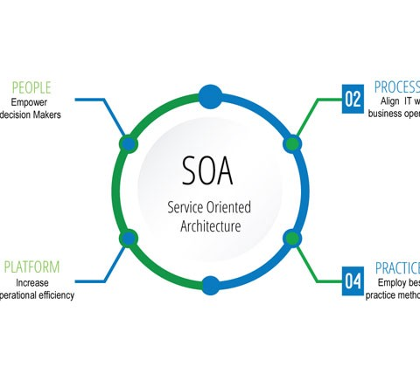
Service-oriented architecture
Service-oriented architecture (SOA) is a framework that facilitates the design of computer systems by enabling communication between individual software modules and their reuse in various contexts. Services conform to standardized interfaces and an overarching architectural pattern to facilitate their seamless integration into emerging software platforms. Consequently, the application developer is relieved from the burden of duplicating or replicating preexisting features, as well as from the need to acquire the knowledge of connecting to or ensuring compatibility with existing functions.

Slide 8
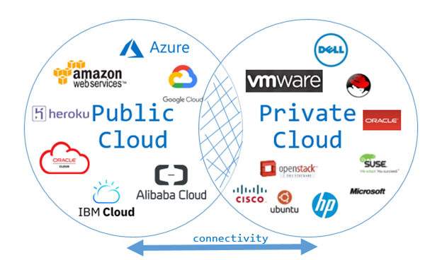
deployment models
Public Cloud
Private Cloud
A "public cloud" is a kind of cloud computing whereby an external service provider uses the internet to make their computing resources accessible to users all over the globe. Users in public cloud computing can choose between free and paid resources on an asneeded or sliding scale. Case in point: Google Cloud.
Private clouds, also known as internal clouds or corporate clouds, limit user access to the underlying infrastructure and software. In addition to the scalability, ease of service delivery, and security that are hallmarks of cloud computing, private clouds offer the benefits of on-premises infrastructure, such as access control and resource customization.

Slide 9
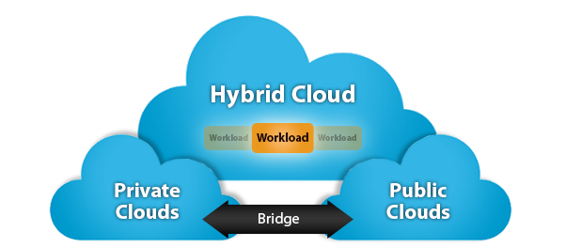
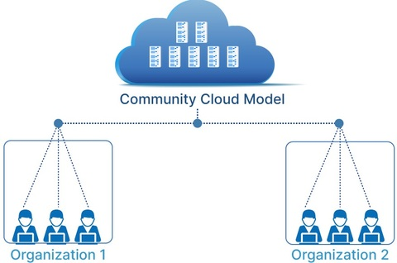
deployment models
Hybrid Cloud
Community Cloud
A hybrid cloud is one in which a business uses both its internal network and third-party cloud services. Companies frequently employ this model when they have an urgent need to increase the capacity of their information technology systems, for example, when a private cloud is supplemented with public cloud resources. During the hectic Christmas season, an e-commerce site may use public clouds to boost the performance of its web applications.
A "community cloud" is an example of a cloud architecture where multiple organizations combine their assets to address common operational and regulatory requirements. The concept of a community cloud is similar to that of a communal garden, in which numerous individuals cooperate to care for a single area of land. Community clouds are a more recent development than public, private, or hybrid clouds.

Slide 10
Security, storage, legal, and privacy issues with the cloud
Data security and privacy are two of the major issues with cloud computing.
Cyberattacks, stolen intellectual property, and broken contracts are all possible outcomes of lax cloud security. The customer service department is another target for hackers.
Privacy and security of customer information is a top concern for many businesses. Regulatory bodies take action when security breaches occur. Companies also have access to sensitive data that gives them an advantage in the market.
Mismanagement of cloud storage can have catastrophic results. Data security and management are concerns with cloud storage.
Data storage providers in the cloud are investigating ways to tighten security measures and limit user access to sensitive data. Data breaches and assaults are more likely to occur when data volumes increase. Thanks to cloud computing, users can store their data in a virtualized environment that is completely out of their hands.

Slide 11
references
BasuMallick, C. (2022, February 9). What Is Cloud Computing? Definition, Benefits, Types, and Trends. Spiceworks.
https://www.spiceworks.com/tech/cloud/articles/what-is-cloud-computing/
Carey, S. (2022, July 22). What is PaaS (platform-as-a-service)? A simpler way to build software applications. InfoWorld.
https://www.infoworld.com/article/3223434/what-is-paas-platform-as-a-service-a-simpler-way-to-build-software-applications.html
Choosing the best cloud computing model for your business How the right model can be a launchpad for success. (2021).
https://assets.ricoh-usa.com/j2jqn9lauv41/hLPQld6XpkyHkRm7c74AD/33fe98efa4f1e2d5d07b1eadfb7e453d/ricoh-cloud-computing-whitepaper.pdf
Differences between the cloud service models iaas, paas, saas & daas – cloud ace singapore. (n.d.). Retrieved December 31, 2024, from
https://sg.cloud-ace.com/differences-between-the-cloud-service-models-iaas-paas-saas-daas/
L, T. (2022, March 28). Platform Virtualization - A Creation of Virtual Machines | Blog Posts. Lumenci.
https://www.lumenci.com/post/platform-virtualization
Risks and Benefits of Cloud Storage - Wheelhouse. (2022). Wheelhouse.com.
https://www.wheelhouse.com/resources/risks-and-benefits-of-cloud-storage-a9881

